Slide 1
Road Accident Analysis
By Prajakta

Slide 2
Given the road accidents dataset sourced from kaggle, which comprises 12,158 rows and 15 columns which includes various factors such as driver demographics, road conditions, and accident specifics, the objective is to predict the severity of road accidents.
Problem Statement
Key Features:
Driver Attributes: Age band, Sex, Educational Level, Driving Experience
Road and Environmental Factors: Road Surface Type, Light Conditions, Weather Conditions, Types of Junction
Accident Details: Type of Collision, Vehicle Movement, Pedestrian Movement, Cause of Accident
Target Variable:
Accident Severity: An integer representing the severity of an accident.

Slide 3
Flow Diagram
Data Collection
Class Imbalance
Outlier,
Skewness
Data Cleaning
EDA
Second
Model
Model Validations
Pre-Processing
Basic
Model
Feature Selection
Third
Model

Slide 4
Data & Cleaning:
Data contain 12,158 Observations and 15 attributes
Target attribute
Accident Severity:
Checking the Missing values:
No Missing Values
Data Type Conversion (Label Encoder)
Duplicate Checking:
Data having a Duplicates

Slide 5
Basic Data Model:
Model Name | Accuracy | Precision | Recall | F1-Score
Logistic Regression | 86.389803 | 1.000000 | 0.863898 | 0.926980
Decision Tree | 73.972039 | 0.828653 | 0.864449 | 0.846173
Random Forest | 85.649671 | 0.989529 | 0.864090 | 0.922565
Support Vector Machine | 86.389803 | 1.000000 | 0.863898 | 0.926980
Naïve Bayes | 86.389803 | 1.000000 | 0.863898 | 0.926980
K-Nearest Neighbour | 86.389803 | 1.000000 | 0.863898 | 0.926980
Conclusion: From above data frame Logistic regression is given the best result

Slide 6
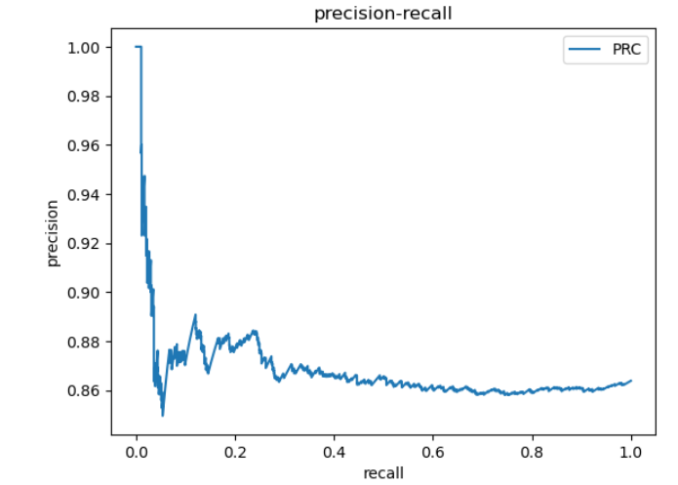
Graph of best fitted model:
Conclusion: My best fitted model is Logistic regression.
PRC

Slide 7
EDA(Exploratory Data Analysis)
Visualization
Class Imbalance
Random Over Sampling
Outliers
Skewness

Slide 8
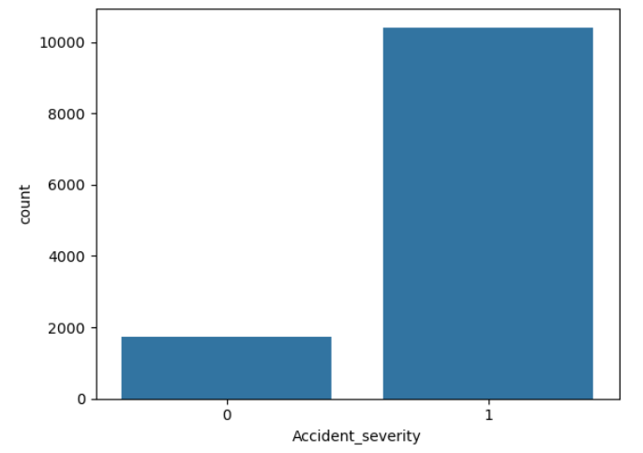
Class Imbalance

Slide 9
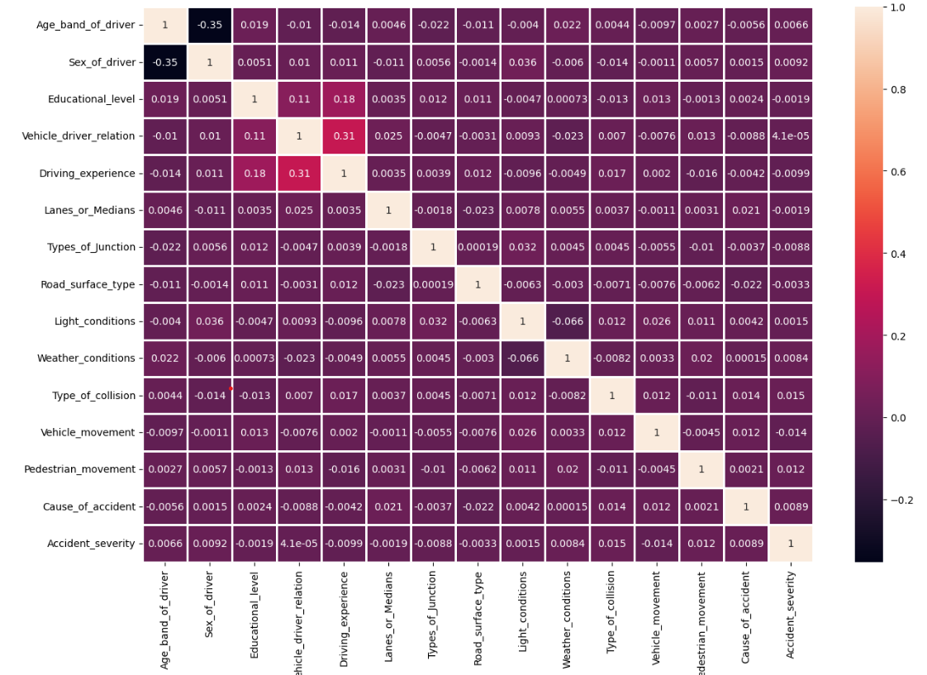
Visualizations:

Slide 10
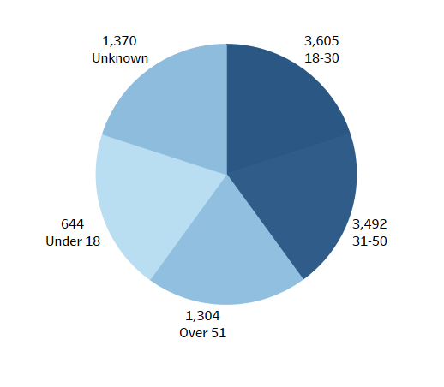
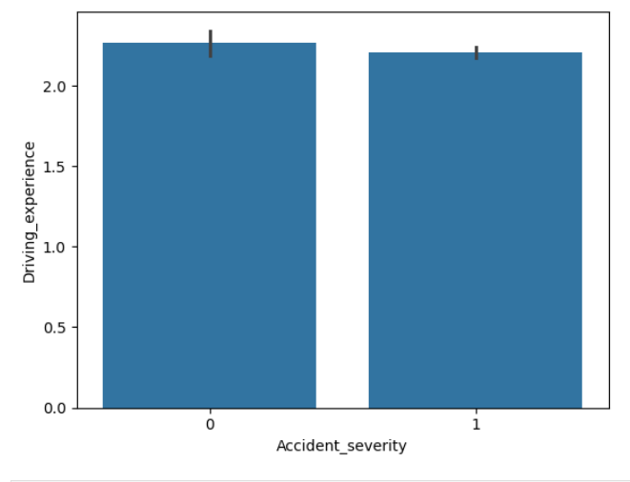
Visualizations:
Conclusion: from above pie chart we can conclude that Age between 18 to 30 and 31 to 50 has high accident count.
Conclusion: from above bar plot we can conclude that less driving experience drivers has high accident count.

Slide 11
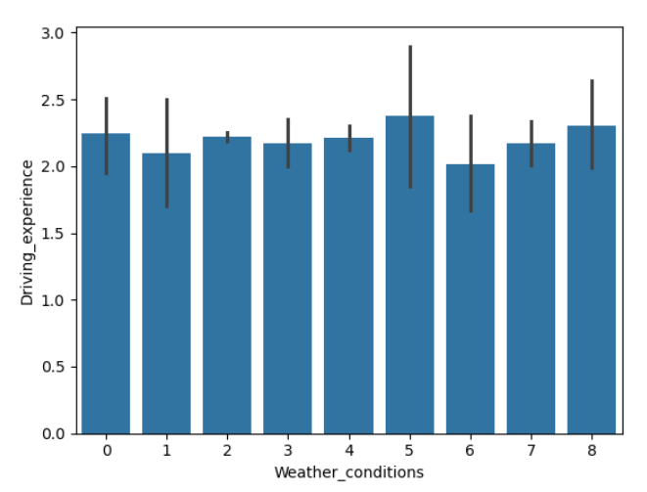
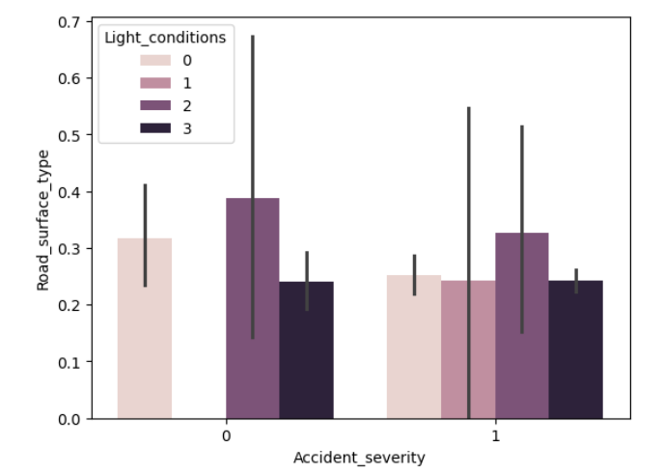
Visualizations:
Conclusion: from above graph we can conclude that weather conditions don't seem to significantly impact the driving experience.
Conclusion: The graph shows that Road_surface_type varies with Accident_severity, and Light_conditions influence this relationship, with noticeable variability especially in conditions 0 and 2.

Slide 12
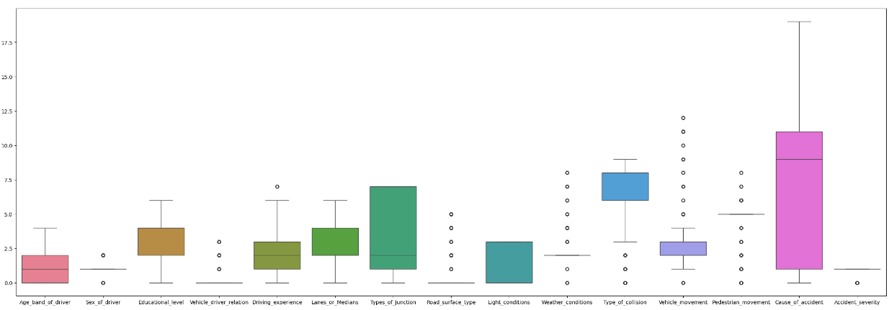
Outliers

Slide 13
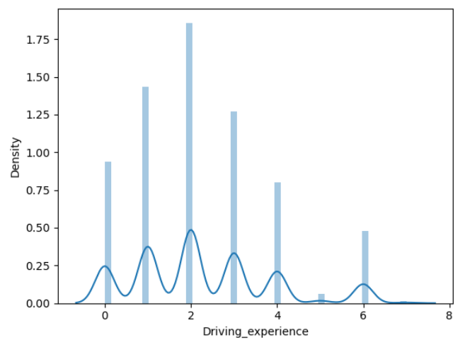
Outliers

Slide 14
Second Data Model:
Model Name | Accuracy | Precision | Recall | F1-Score
Logistic Regression | 52.040326 | 0.576205 | 0.507799 | 0.539843
Decision Tree | 96.015362 | 0.928220 | 0.989518 | 0.957889
Random Forest | 89.942391 | 0.801868 | 0.990285 | 0.886172
Support Vector Machine | 57.729237 | 0.599312 | 0.563048 | 0.580614
Naïve Bayes | 51.752280 | 0.537365 | 0.505550 | 0.520972
K-Nearest Neighbour | 59.433509 | 0.508850 | 0.599652 | 0.550532
Conclusion: From above table Random Forest is giving me best result.

Slide 15
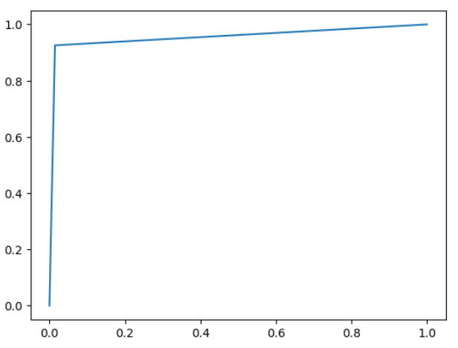
Graph of best fitted Second model:
Conclusion: My best fitted model is Random Forest.
AUCROC

Slide 16
Third Data Model:
Model Name | Accuracy | Precision | Recall | F1-Score
RFE | 82.058310 | 0.745158 | 0.869203 | 0.802415
Chi-square | 75.654124 | 0.697248 | 0.781268 | 0.736870
Conclusion: feature selection is not suitable for my data because it is reducing the Accuracy of a model

Slide 17
Cross Validation
Techniques | Validation
Cross validation | 0.94
Stratified K-Fold | 0.94
Conclusion: For the Random Forest model, the validation results indicate a strong performance, with both Cross validation and Stratified K-Fold producing a validation score of 0.94.

Slide 18
Draw-Back
Despite the high cross-validation score, the model may struggle with unseen, real-world data, especially if the data distribution changes over time. These issues point to areas where refinement is needed to enhance the model’s robustness and applicability.

Slide 19
Thank You

